Slide 1
PRESENT PERFECT

Slide 2
FORM

Slide 3
Present Perfect
To make the present perfect, put have/ has with the past participle
Subject + have + Verb (p.p) + Complement
has
He has gone to London
They have gone to London

Slide 4
Affirmative
(Regular verbs)
I have worked
you have worked
he/she/it has worked
we have worked
they have worked
(Irregular verbs)
I have seen
you have seen
he/she/it has seen
we have seen
they have seen

Slide 5
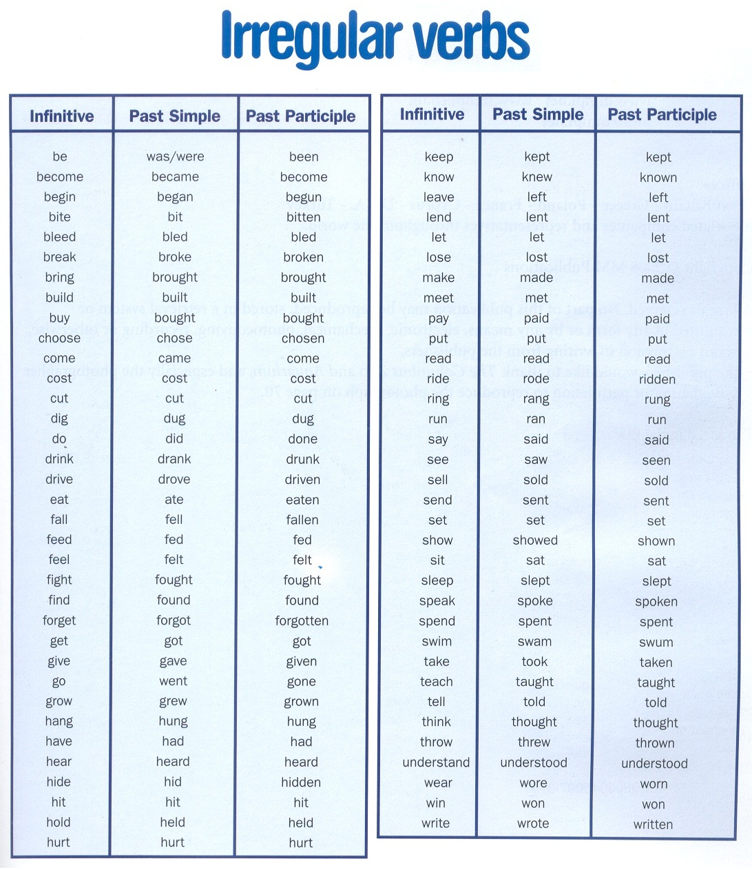

Slide 6
Negative
Subject + have + not+ Verb (p.p) + Complement
has
He has not gone to London
They have not gone to London

Slide 7
Negative
(Regular verbs)
I have not worked
you have not worked
he/she/it has not worked
we have not worked
they have not worked
(Irregular verbs)
I have not seen
you have not seen
he/she/it has not seen
we have not seen
they have not seen

Slide 8
Question
has + Subject + Verb (p.p) + Complement + ?
have
has he gone to London ?
have they gone to London ?

Slide 9
Question
(Regular verbs)
Have I worked?
Have you worked?
Has he/she/it worked?
Have we worked?
Have they worked?
(Irregular verbs)
Have I seen?
Have you seen?
Has he/she/it seen?
Have we seen?
Have they seen?

Slide 10
Spelling of regular affirmative past participle forms
1.Most regular verbs: add –ed
work: worked
stay: stayed
show: showed
wonder: wondered
visit: visited
rain: rained

Slide 11
Spelling of regular affirmative past participle forms
2.When the simple form of a verb ends in e, only d is added.
hope: hoped
decide: decided
change: changed
dance: danced
like: liked

Slide 12
Spelling of regular affirmative past participle forms
3. When a one–syllable verb ends in a single consonant (excepting w or y) precede by a single vowel ,the final consonants is doubled and ed is added.
shop: shopped
stop: stopped
plan: planned

Slide 13
Spelling of regular affirmative past participle forms
4.When a verb of more than one syllable ends in a single consonant preceded by a single vowel, the final consonant is doubled when the final syllable is stressed.
omit: omitted
occur: occurred
refer: referred
regret: regretted
But if the last syllable is not stressed
don’t double
offer: offered
visit: visited
listen: listened
wonder: wondered

Slide 14
Spelling of regular affirmative past participle forms
5.Verbs ending in consonant+-y: change y to i and add –ed
hurry: hurried
cry; cried
study: studied
try: tried
reply: replied
But (vowel+ -y):
play: played
enjoy: enjoyed

Slide 15
Spelling of regular affirmative past participle forms
-Two vowels: don’t double
seem: seemed
wait: waited
-two consonants :don’t double
want: wanted
help: helped
-Verbs ending in-c have ck in the past.
picnic: picnicked
Panic: panicked
-In British English,-l is doubled in the past after one short vowel even if the vowel is not stressed:
travel: travelled.

Slide 16
Contractions
Contraction | Pronunciation | Meaning
I’ve | /aiv/ | I have
you’ve | /ju:v/ | you have
he’s | /hi:z/ | he has
she’s | /si:z/ | he has
it’s | /its/ | it has
we’ve | /wi:v/ | we have
they’ve | /oeiv/ | they have
hasn’t | /haeznt/ | has not
haven’t | /haevnt/ | have not

Slide 17
Make affirmative present perfect sentences:
Examples
I (speak) to the boss.
I have spoken to the boss.
She (forget) my address.
She has forgotten my address.
I (make) a mistake.
I have made a mistake.
Alan (work) very hard.
Alan has worked very hard.

Slide 18
Examples
Make negative present perfect sentences:
They (eat) anything.
They haven’t eaten anything.
You (shut) the door.
You haven’t shut the door.
I (hear) from Mary.
I haven't heard from Mary.
John (learn) anything.
John hasn’t learnt/learned anything.

Slide 19
Examples
Make present perfect questions:
John/leave?
Has John left?
Why/Mary/go home?
Why has Mary gone home?
Where/you/put the keys?
Where have you put the keys?
We/pay?
Have we paid?
Why/Andy and Sarah/bring the children?
Why have Andy and Sarah brought the children?

Slide 20
USE

Slide 21
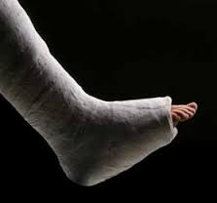
Use of present perfect
We use the present perfect especially to say that a finished action or event is connected with the present in some way.
If we say that something has happened, we are thinking about the past and the present at the same time.
I can’t go on holiday because I have broken my leg.
(Not I can’t go on holiday because I broke my leg.)

Slide 22
Use of present perfect
Present perfect: thinking about the past and present at the same time
I can’t go on holiday because I’ve broken my leg.
Finished action Connection with
Past Now

Slide 23
Use of present perfect
We do not use the present perfect if we are not thinking about the present.
Compare:
I’ve travelled in Africa a lot.
(=I know Africa.)
Some people think that Shakespeare travelled a lot in Germany.
(Not Some people think that Shakespeare has travelled a lot in Germany.)

Slide 24
Use of present perfect
We’ve studied enough to pass the exam.
(The exam is still to come)
We studied enough to pass the exam.
(The exam is over)

Slide 25
Use of present perfect
We normally use the present perfect to announce news of recent events.
Andy has won a big prize!
Have you heard? Uncle George has crashed the car again.
After announcing news, we usually use the simple past to give more details.
Andy has won a big prize! Because he worked very hard.
Have you heard? Uncle George has crashed the car again.
He ran into a tree in High Street.

Slide 26
Present perfect for news
Uncle George has crashed the car again.
finished action news now
Past Now
Simple past for details
He ran into a tree in High Street.
past details
Past Now

Slide 27
Use of present perfect
Time words
When we talk about finished events with words that mean ‘at some/any time up to now’ (like ever, before, never, yet, recently, lately, already), we normally use the present perfect.
Have you ever seen a ghost?
I’m sure we’ve met before.
She’s never said ’sorry’ in her life.
Has the postman come yet?
We haven’t seen Beth recently.
Could you clean the car? ~I’ve already done it.

Slide 28
Use of present perfect
Note the difference between gone (to) and been (to)
Jim is on holiday. He has gone to Italy.
(=he is there now or on his way there)
Jane is back home now. She has been to Italy.
(=she has now came back)

Slide 29
We use the present perfect with today, this evening, this year etc., when these periods are not finished at the time of speaking.
I haven’t seen John this week.
Rob hasn’t studied very hard this term.
I’ve drunk four cups of coffee today.

Slide 30
This is the first time etc
We use a present perfect after this/it/that is the first/ second/ third/only/ best/ worst time.
-This is the first time that I’ve heard her sing. (Not This is the first time that I hear her sing.)
-It’s the fifth time you’ve asked me the same question.
-This is only the second opera I’ve ever seen.

Slide 31
for and since can both be used with a present perfect to talk about duration up to the present. They are not the same.
Compare:
for+ period of time
I’ve known her for three days.
.
since+ starting point
I’ve known her since Tuesday.
.

Slide 32
I’ve been here for three days.
I’ve known Mary for a very long time.
I’ve had this car for six months.
I’ve been here since Tuesday.
I’ve known Mary since 1980.
I’ve had this car since April.

Slide 33
Use of since or for.
1…………..six weeks
2…………..Sunday
3…………..1998
4…………..ten years
5…………..yesterday
6……………last week
7……………this morning
8……………a day
9……………July
10………….a long time
1.For
2.Since
3.Since
4.For
5.Since
6.Since
7.Since
8.For
9.Since
10.for

Slide 34
How long?
We use a present perfect to say how long a situation or action has continued up to now.
Compare:
I know her well.
I’ve known her for years.
(Not I know her for years.)

Slide 35
Compare also:
How long are you here for?
(=until when; when are you leaving?)
How long have you been here for?
(=since when; when did you arrive?)

Slide 36
Present perfect with past time expressions
Present perfect with past time expressions:
Grammars usually say that the present perfect cannot be used together with expressions of finished time, like yesterday, last week, then, when, three years ago, in 1970.
This is because the present perfect focuses on the present, and words like these focuses on the past, so they contradict each other.
We can say:
I have seen him.
OR
I saw him yesterday.
BUT
not (I have seen him yesterday)
.
In fact, such structures are unusual but not impossible

Slide 37
Here are some real examples taken from news broadcasts, newspaper articles, advertisements, letters and conversations.
The horse’s trainer has had a winner here yesterday.
A 24-year-old soldier has been killed in a road accident last night.

Slide 38
In American English the simple past is often used to give news.
Did you hear? Switzerland declared war on Mongolia!
In British English
Have you heard? Switzerland has declared war on Mongolia!

Slide 39
Repetition up to now
We can use the present perfect to say that something has happened several times up to the present.
I’ve written six letters since lunchtime.
Adverbs of frequency like often, sometimes, occasionally are common with the present perfect.
How often have you been in love in your life?
I’ve sometimes thought of moving to Australia.

